Slide 1

Image Super-resolution for OCT and CT images using deep learning method
Dingyan Chen
4276853
Supervisor: Bai Li

Slide 2
Outline
Definition of super-resolution
Past work - SRCNN
My Design
GAN and ResNet
Network Design
Evaluation and result

Slide 3
Definition of Super-resolution
Super-resolution(SR) is the process to transform low-resolution(LR) image or video to high-resolution(HR).
Input: 2D piece of OCT and CT Images
Output: High-resolution Images

Slide 4
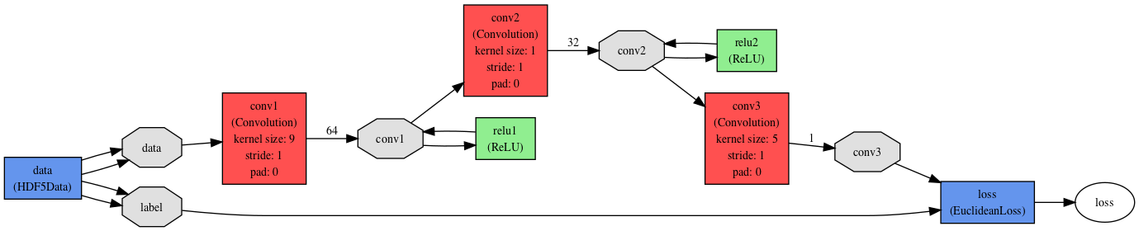
Past work based on deep learning- SRCNN (The Chinese University of Hongkong,2015)
Four steps:
Preprocessing
Patch extraction and representation
Non-linear mapping
Reconstruction

Slide 5
My Design
Based on SRCNN, can I improve it?
Or if there is any other better substitution for CNN?

Slide 6
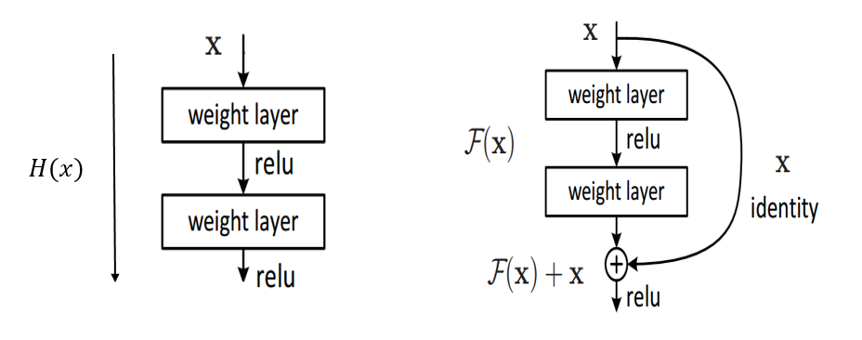
ResNet
Better approach than CNN
CNN will encounter gradient vanishing if you set many layers
But using “shortcut” in ResNet(residual block), it will solve the issue
Figure: Normal CNN vs CNN with Residual Connection

Slide 7
GAN
Cost Function
With this approach our generator can learn to create solutions that are highly
similar to real HR images and thus difficult to classify by D.

Slide 8
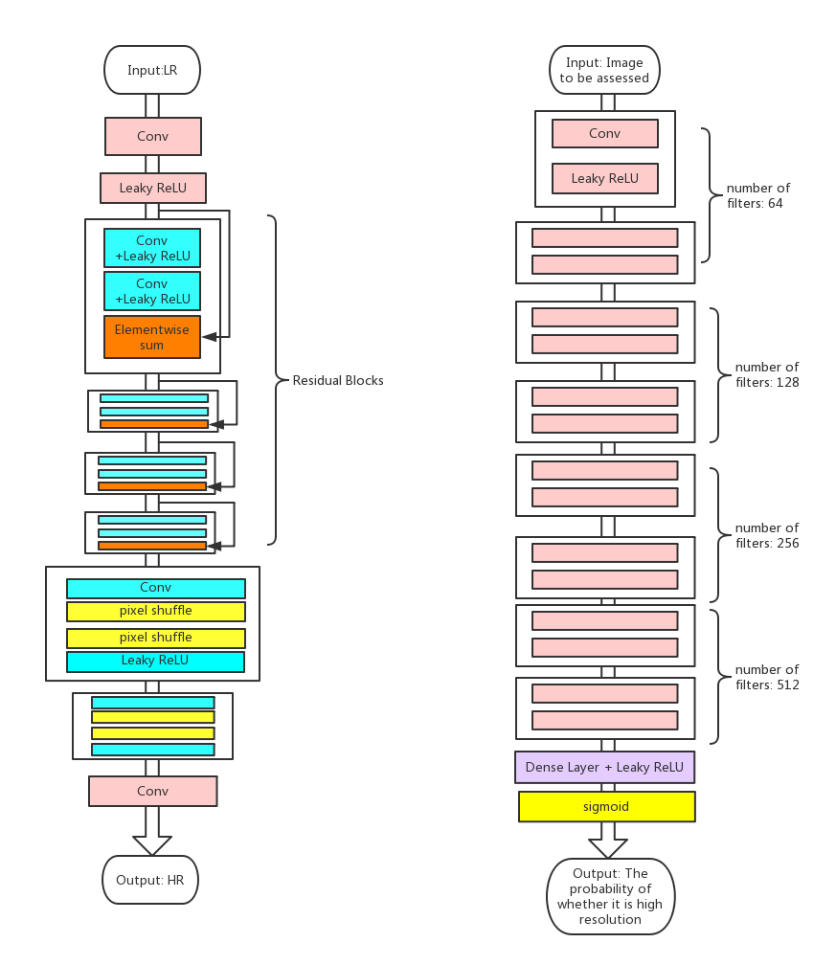
Generator model
(Use ResNet within the model)
Discriminator model:
The idea of filters originally comes from VGG19 network
Use RAISE dataset to train(8000+ HR images)
Use pre-trained VGG19 network to initialize the parameter

Slide 9
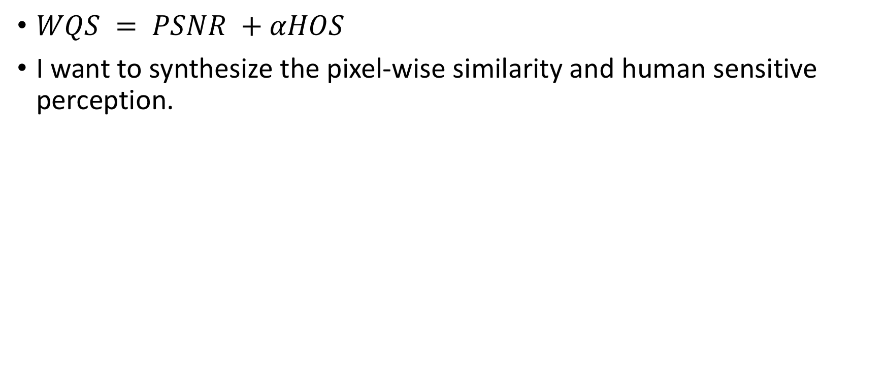
Evaluation
$WQS = PSNR +αHOS$
I want to synthesize the pixel-wise similarity and human sensitive perception.
Number of favors | HOS
25-30 | 10
20-24 | 8
15-19 | 6
10-14 | 4
under 10 | 2

Slide 10
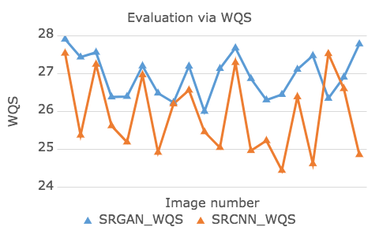
Evaluation
Data collection

Slide 11
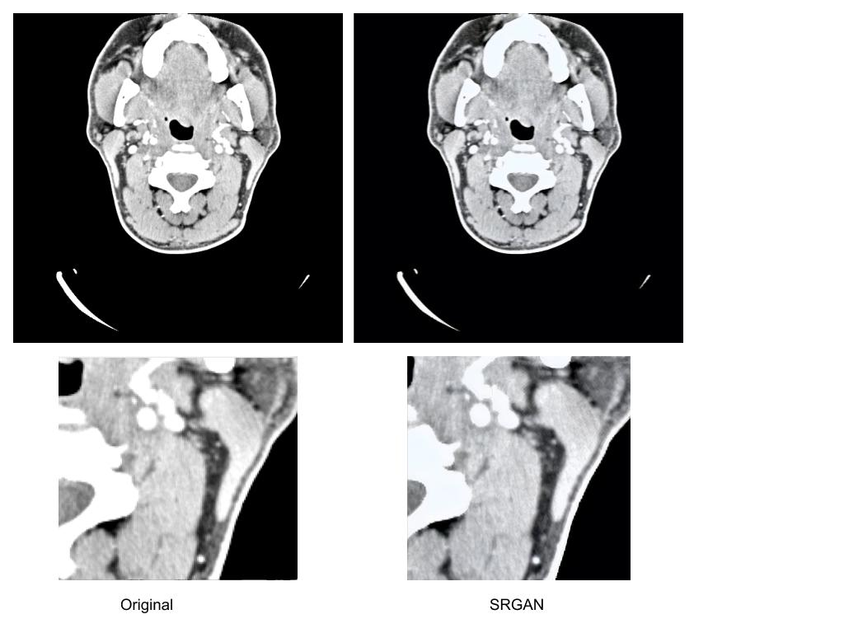
Result
Two advantages of my method:
Scale up the image by 4x
The detail is more smooth
Drawbacks:
The result is generated, therefore, this might not be actual
Bad effects on some imageset

Slide 12
Thank You

Slide 13
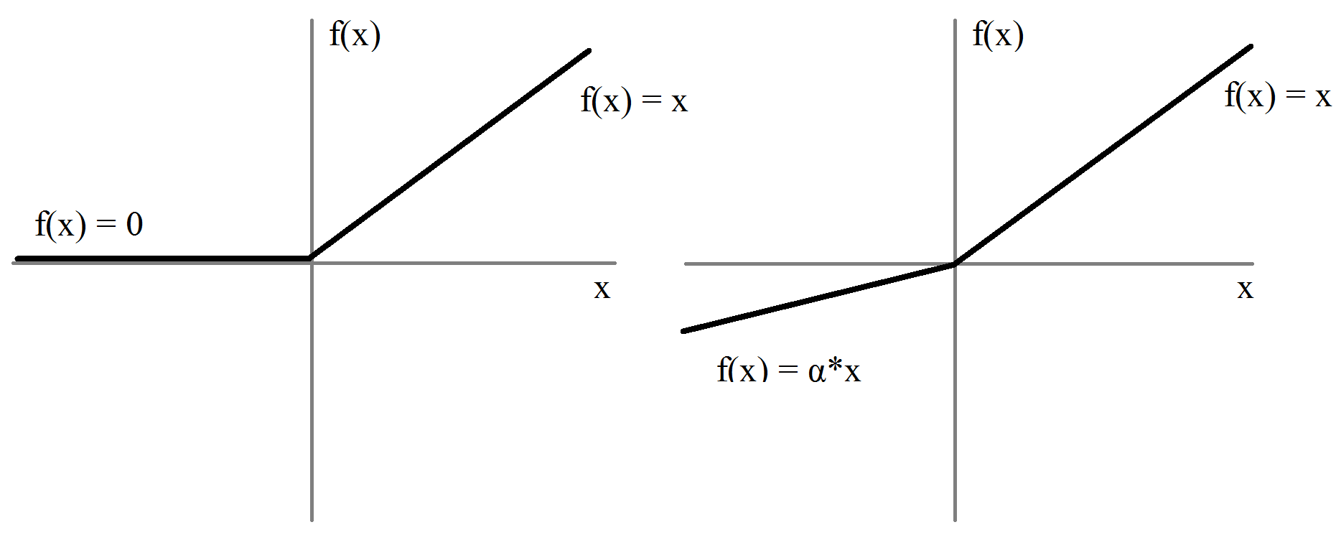
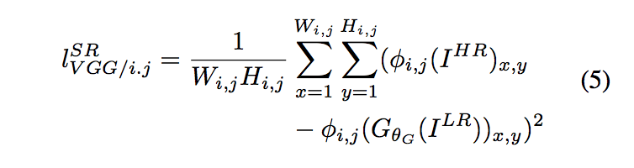
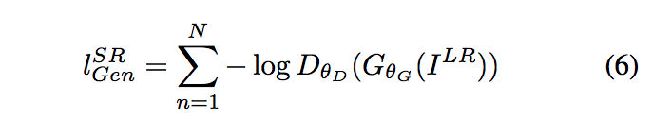
Challenges in design
Network Design(How to make a better network)
Whether batch normalization is useful?
How to build a better activation function?
Leaky ReLU instead of ReLU to avoid “dead ReLU problem”
How to develop a perceptual loss function instead of MSE?
Total loss = content loss(MSE) + adversarial loss
Training Process
Too slow
+

